Slide 1





US ROWING
Results and Recommendations
Bisan Alhmood - Project Manager/Strategist
Katniss Chen - Technologist
Jessica Cheng- Insights
Marko Konte - Researcher
Huanyu Ma - Analyst
Serhiy Pylawka - Project Manager/Strategist
Winny Shen- Strategist
Hector Silva - Communicator

Slide 2
Hypothesis Overview
After conferring with US Rowing and the Columbia Rowing team, the project team settled on a simple hypothesis:
A happy athlete = A better performing athlete
The bulk the project team’s work centered around attempting to prove this hypothesis and answer two key questions:
How to measure “happiness”
How to tie this measurement to performance.

Slide 3
Analysis Results
Data Description:
CU Sports took the class of 2020 (the current senior class) data and pulled their data through their first 3 years.
Pre-frosh is survey data CU collected when students arrived on campus in their 1st year. The questionnaire asks students to rate their level of life satisfaction, sense of environmental mastery, emotional health, quality of relationships, sense of autonomy, self-acceptance, satisfaction with academic functioning, health, and fitness, sense of purpose in life, personal growth on a scale of 1-10 points. This data was collected prior to the start of school.
We took a look at the performance variable and the answers to the 10 well-being survey questions to discover some correlation.
Conclusion:
For pre-frosh data, well-being and performance are negatively correlated.
Interpretation:
The underlying logic may be the higher performance requires more exercise, causing higher stress to athletes. Or athletes who perform better have higher requirements on themselves and it influence their perception of well-being.

Slide 4
However, the conclusion is not robust and is hard to give suggestions
Obstacles:
Small data volume. Even less about rowing. The data is from all sports clubs of CU.
No comprehensive indicator of well-being. The 10 questions only focus on mental aspects.
Data is not persuasive. The well-being data is all self-reported which is highly subjective. The performance data is rated by coaches.
Lack of data across seasons. We need to collect well-being data continuingly to check the trend and stability.
No comprehensive indicator of performance. Eg: no post-season data of variable “performance” so we had to use "satisfaction with athletic experience” as an alternative.

Slide 5
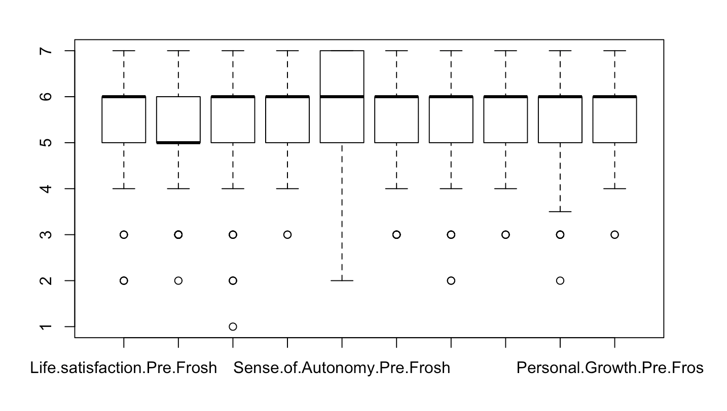
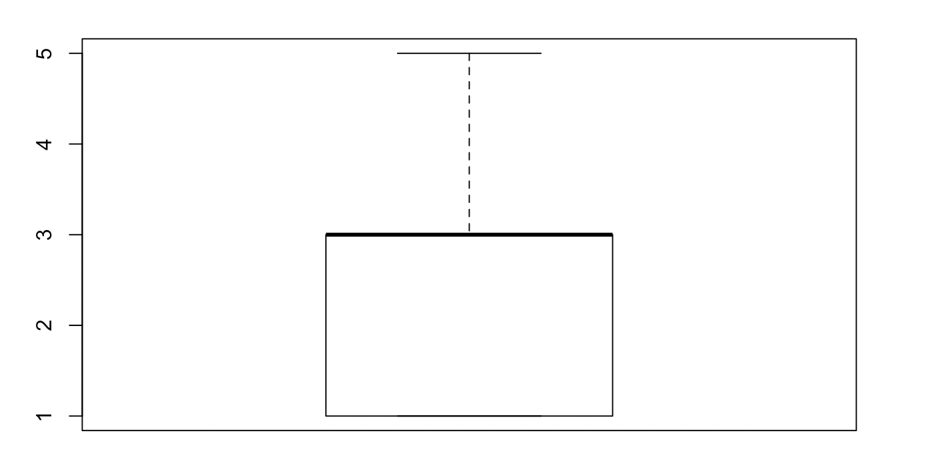
Data Overview: Hard to interpret because the data is skewed.
The box plot (Figure 1) show answer distribution for each of ten wellness survey questions (scaled 1-10) and in Figure 2 coaches assessment of athlete performance (scaled 1-5).
From Picture 1, we can see that the data is highly skewed. The answers to the ten well-being questions fell in 1-7 (scaled 1-10). From Picture 2, the majority of performance fell in 1-3 (scaled 1-5).
Problem:
Maybe because these are challenging questions to answer and too many elements influential.
Suggestion:
Redesign the questions. Simplify the questions.
Focus on the influence of well-being on training and performance.

Slide 6
Suggestion:
Note that the well-being variables here are 10 survey questions that represents athletes’ self-satisfaction with training, which is more like emotional health. The conclusion is not robust because we lacked physical part of well-being such as heart rate variability, sleep quality etc.
We need to collect more data of both mental and physical health to form a comprehensive well-being indicator.
Redesign the questions to quantify mental well-being. (We have some suggestions in the following slides.)
We also need a more comprehensive performance indicator. Right now we are considering a combination of split and watt data etc. Still need to check the correlation between split, watt with race performance.
We will try to track the time-series of athletes’ well-being and performance fluctuation and give suggestions on training strategy.

Slide 7
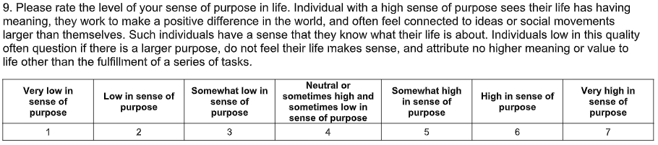
Columbia Questionnaire Issues
The Columbia Questionnaire meant to capture some wellness factors was supplied to the team, however several issues were discovered. Primarily, the team was unable to discern any statistically significant link between wellness and performance. Looking more closely at the actual questionnaire, the team determined it was not fit-for-purpose
Below is an example of a question from this questionnaire and concerns from the team:

Slide 8

Concerns:
Question is confusing and too broad
This question is being asked of a high-school student, however even adults struggle to define a “sense of purpose” or what having one might look like
There are many confounding variables which can affect a “sense of purpose”
The scaling of the answers is very strange - would expect a 1-5 scale

Slide 9

Recommendations
Our recommendation is based on improving the decision making apparatus by having a robust model of
Data Collection -> Analysis -> Display ->
.
Notes:
Secondly, the table and graph show the top 10 cities for car sales. Houston of Taxes is the largest used car online selling market with over 12k car sales, followed by san antonio of Texas. So potential car buyers are highly recommended to buy cars from Texas because the car volume is high so it can be easier to find a satisfying car there.

Slide 10
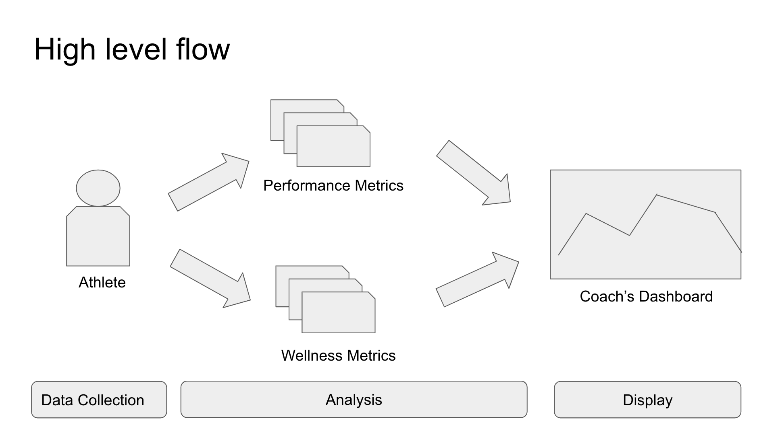

Slide 11
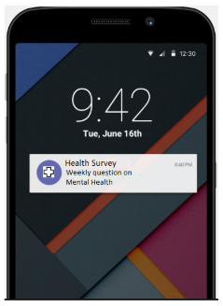
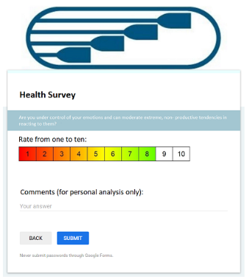
Data Collection - Wellbeing
Timing:
Questions asked once or twice a week via an app
They will get phone reminders
Length of data capture:
20 weeks - 20 to 40 data points
Columbia - Start of Spring 2020 (Jan) to last regatta
US Rowing January to Tokyo Olympics (June/July)
Question Types
Key categories in which questions will be asked: Stress, Joy, Personal Growth, Nutrition/ Hydration
Categories are rotating
Athletes do not address the category on the same day
Weekly spread to avoid attrition and test training
-
Notes:
Our first analysis is on numerical variables: price, year, mileage. We want to see how the three variables are correlated. The heatmap visualises the correlation. From the figures and the colour of the cells, we can conclude that there is a moderate positive correlation between price and year, which means the newer the car, the higher the price is. There is a moderate negative correlation between price and mileage, so higher the mileage, the lower the price. There is a relatively strong negative correlation between year and mileage, thus the older the car, the more distance is likely to be travelled.

Slide 12
Data Collection - Mental Health Survey Proposal
Category Measurement | Question | Strongly Disagree (1) | Somewhat Disagree (2) | Do not Agree or Disagree (3) | Somewhat Agree (4) | Strongly Agree (5)
Stress Level | The current demands on my time and energy are manageable
 | The level of stress I’m under is optimal for my performance
Joy | My sport brings me joy
 | My relationship with my teammates enhances my performance
Personal Growth | My efforts to improve my athletic performance over the past month have paid off
 | I’ve been able to achieve my goals over the last month
Nutrition | I had a balanced, healthy diet yesterday
Hydration | I generally feel well hydrated
Notes:
We further plotted scatter plots of price against year and price against mileage to confirm the positive relationship between price and year, and also the negative relationship between price and mileage.
Since variables year and mileage only have moderate correlations with price, so there might be other factors affecting car prices that we will explore in the following parts such as location, model, and make.

Slide 13
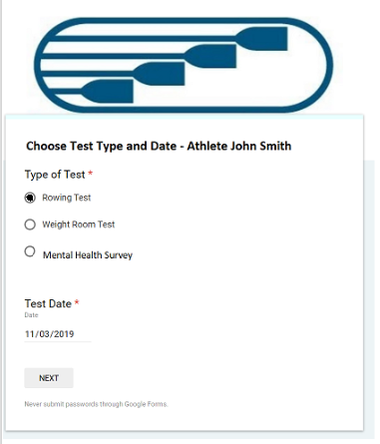
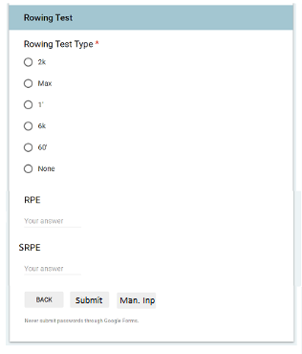
Data Collection - Athletic Performance
Manual or automatic input of results of rowing tests on land
The athlete will input:
RPE (how they are feeling)
SRPE (the exertion level of the session).
Optional manual input of results (split time and watts), although that is generally inputted by coaches.
Common Variables:
Name
Date
Test Type (alongside number value for multiple tests).
RPE and SRPE Data for that date and athlete name will be used for analysis in correlation to rowing performance.

Slide 14
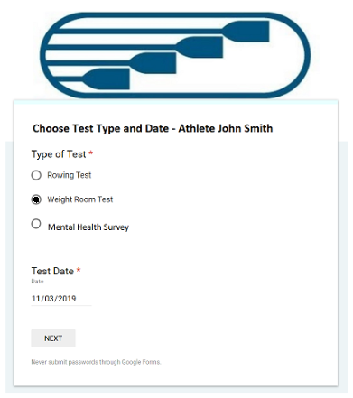
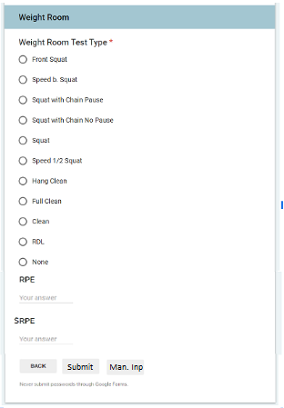
Data Collection - Weight Room Metrics
Which ability to manually input exertion and test details from 2o different weight room tests.
Common variables:
Name, Date, and Test type.
Which Athlete will in put
RPE(how they are feeling)
SRPE(the exertion level of the session)
Performance(lifts, reps)
RPE and SRPE data will be used
for analytical purposes by future
Students or analysts.

Slide 15
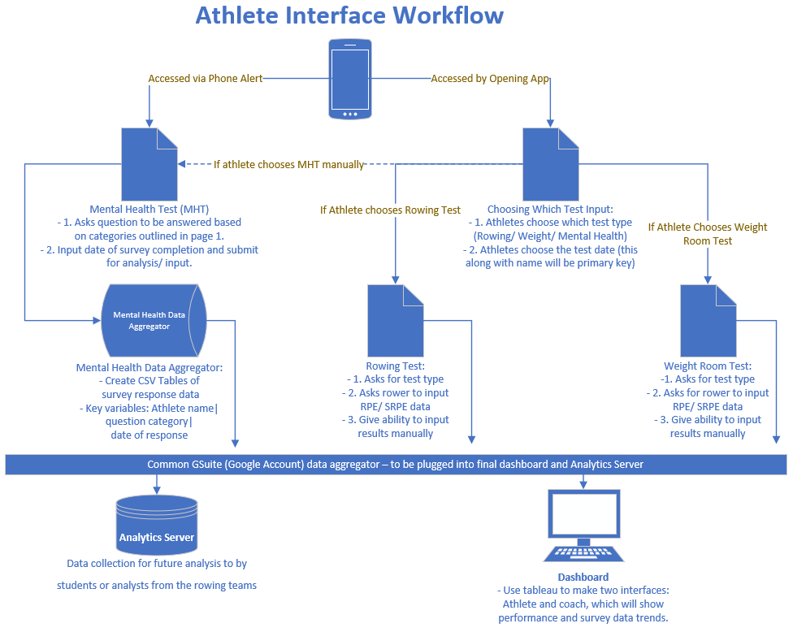
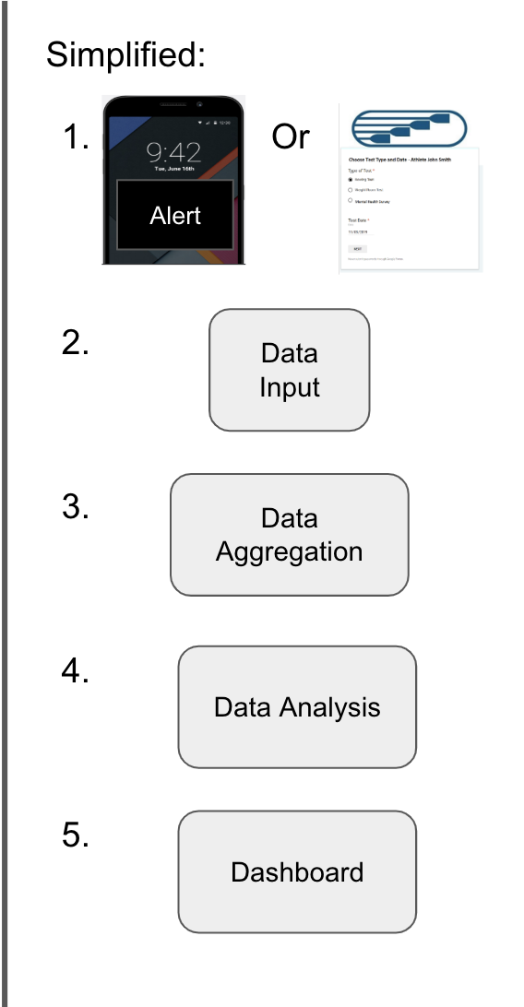

Slide 16
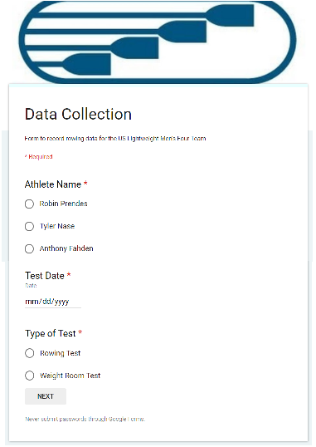
Data Collection - Coaches Interface
Inputting performance data from rowing and weight room test results for Coaches
Common variables:
Athlete name
Date of test
Test Type (Rowing/ Weight) & secondary test type in each category
Sensitive Athlete data (Mental Health answers) will be anonymized or hidden
Rowing Test:
Test types:
2k/ Max/ 1’/ 6k/ 60’/ 60’
Test inputs:
Split/ Split Goal
Watt/ Watt Goal
Weight room test:
Test types:
Front Squat/ Speed Squat/ Squat Chain Pause/ Squat Chain no Pause/
Squat/ Speed .5 Squat/ Hang Clean/ Full clean/ Clean/ RDL
Test Inputs:
Set/ Reps/ Kg
Watt Reached/ Watt Goal
.
Notes:
For conclusions and recommendations, the first important insight we found is that price range across states for different models and brands is different, so location is something to consider when purchasing a second-hand car. A car buyer might go to a nearby state to purchase a car with a lower price, however, he/she also needs to consider other factors like regulations, taxes, transportation costs and so on.

Slide 17
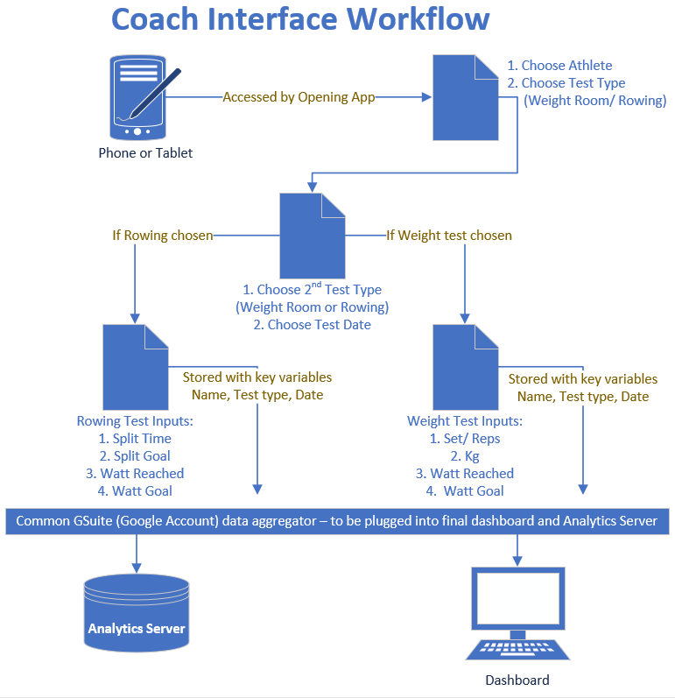
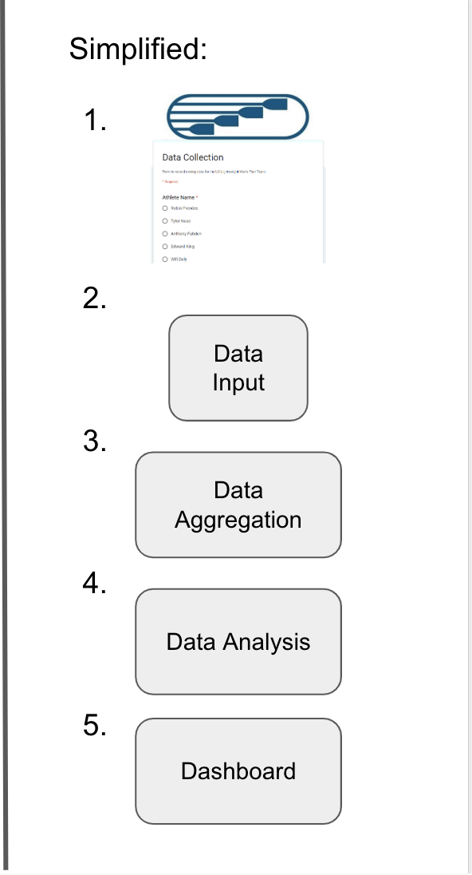

Slide 18
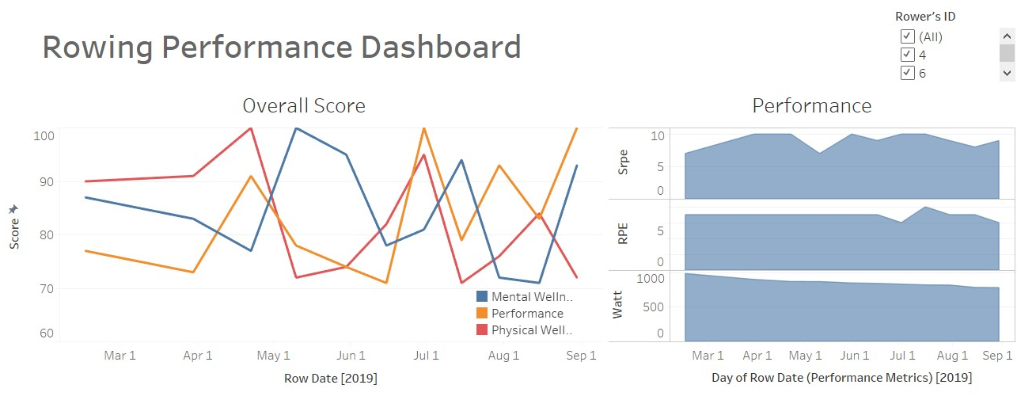
Analysis and Display - Coach’s View
In our proposal dashboard, coaches would see a summarized view of wellness and performance metrics for athletes

Slide 19
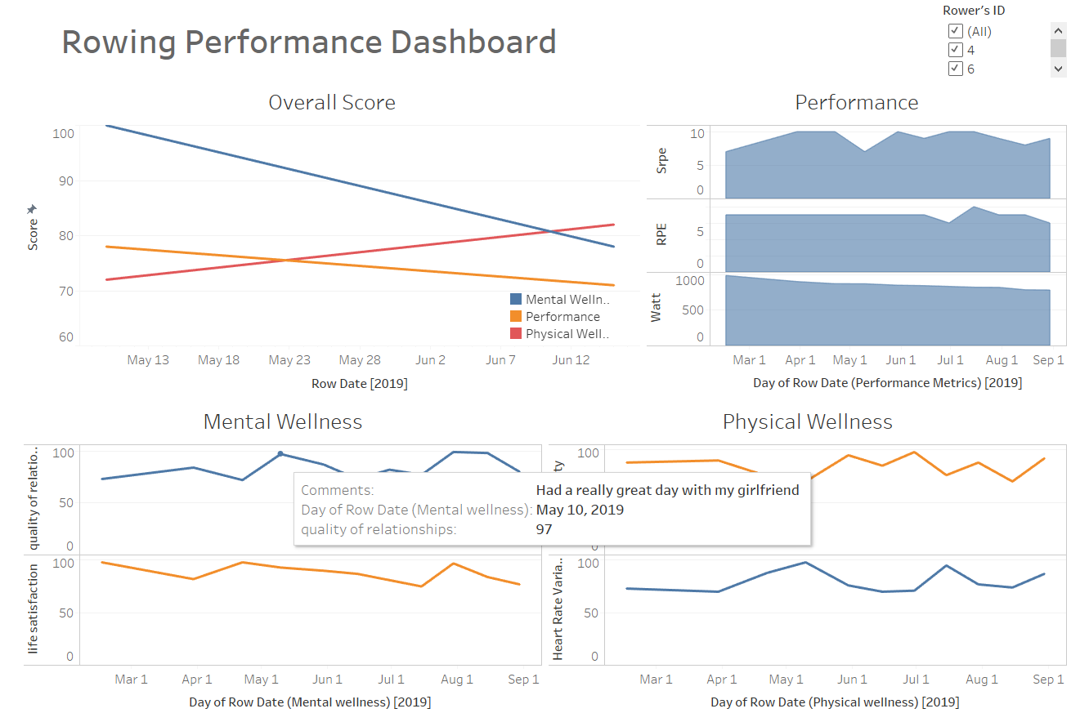
Analysis and Display - Athlete’s View
They would also have the ability to view metrics by date and comments added by the athlete.
They would also have the ability to view metrics by date and comments added by the athlete.

Slide 20
Taking Project forward
2020 Spring Plan
On January 13th- start answering mental health data questions
On each workout or performance session, input results from athlete and coach
End of the season’s
Columbia Rowing: May 31st is last regatta
US Olympics: Tokyo 2020 starts end of July
By the above dates, the data gathered through the season can be used for greater analysis by the summertime capstone program.
Integrating greater information into dashboard:
Integrate data from applications such as whoop to include health based data into dashboard.
Continue with trend analysis between well being & exertion response and performance from weight or rowing performances
Continue growing with more user friendly application solutions for delivering insight

Slide 21
Conclusion
A limited correlation between performance and high mental health was found, however we have determined this is due to the collection methods for the mental health metrics
To solve for this, the team is proposing applying a more concise athlete survey to capture mental wellness metrics
Well controlled study would be ideal
We have created a framework for data collection, aggregation and output, for a dashboard or further analysis
We hope that our recommendations will improve the process of Data Collection -> Analysis -> Display -> Decision

Slide 22

Q&A

